Slide 1

The impact of fire on reported presence of endangered animals in California Deserts using open-source data
Marina Goldgisser
York University
Graduate Program in Geography
Master’s of Science Oral Examination
Advisor: Christopher Lortie
Supervisory Committee Member: Tarmo K. Remmel

Slide 2


Presentation Outline
Background & objectives
Methodology
Findings
Implications

Slide 3
Presentation Outline
Background & objectives
Methodology
Findings
Implications

Slide 4
Background – Deserts
The Mojave, San Joaquin, and Sonoran deserts will experience increased fire activity in response to future climatic change and the invasion of non-native grasses.
Insert images:
Dome fire
Figure adapted from other paper
Invasion of grasses in desert

Slide 5
Background – Animal communities
Desert animals often rely on shrub habitat for foraging (Lortie et al., 2016), nesting (Kozma & Mathews, 1997; Pidgeon et al., 2003), thermoregulation (Kerr & Bull, 2004; Ivey et al., 2020; Lortie et al., 2022), and protection from predators (Kotler, 1984).
Insert images:
Birds nesting; cavity nesters
DGT or lizards thermoregulations
Dens or small mammals

Slide 6
Background – Open source data and citizen science
Ecologists are faced with both limited time and resources (e.g., funding, trained personnel) when it comes to tracking, understanding, and addressing the effects of large-scale environmental disturbances (Williams et al., 2020).
Citizen science offers a potential source of increasing support to ecological research and can help scientists meet the challenges of timely monitoring and assessment of impacted biodiversity following a large-scale environmental disturbance–like wildfires (Lawson et al., 2015; Kirchhoff et al., 2021).
Insert images:
California Native Plant Society Fire Followers
Articles about eBird and fire studies
Notes:
Include information about how much area the desert takes up and overall fire size.

Slide 7
Research Questions
(1) Has the trend in ES occurrences changed in recent decades across southwestern desert regions and have these trends been impacted by the presence of fire?
Examine the trend in ES occurrences reported across three major desert ecoregions from 1995 to 2020 and evaluate how these trends varied according to fire activity
(2) Has the occurrence of fire impacted the number of ES occurrences reported?
Evaluate the impact of fire activity on ES occurrences by comparing pre-fire and post-fire ES reporting
(3) Is there a long-term (20-year period) impact on ES communities in deserts post-fire and do these trends vary by desert region?
estimated the post-fire recovery trend for ES across the different desert regions by calculating a similarity index comparing ES species diversity in burned areas and areas that have no historical reports of burns as far back as the early 1900s
Notes:
This study used open-source biodiversity data from GBIF to examine the impacts of fire on endangered species (ES) in California desert systems.

Slide 8
Presentation Outline
Background & objectives
Methodology
Findings
Implications

Slide 9
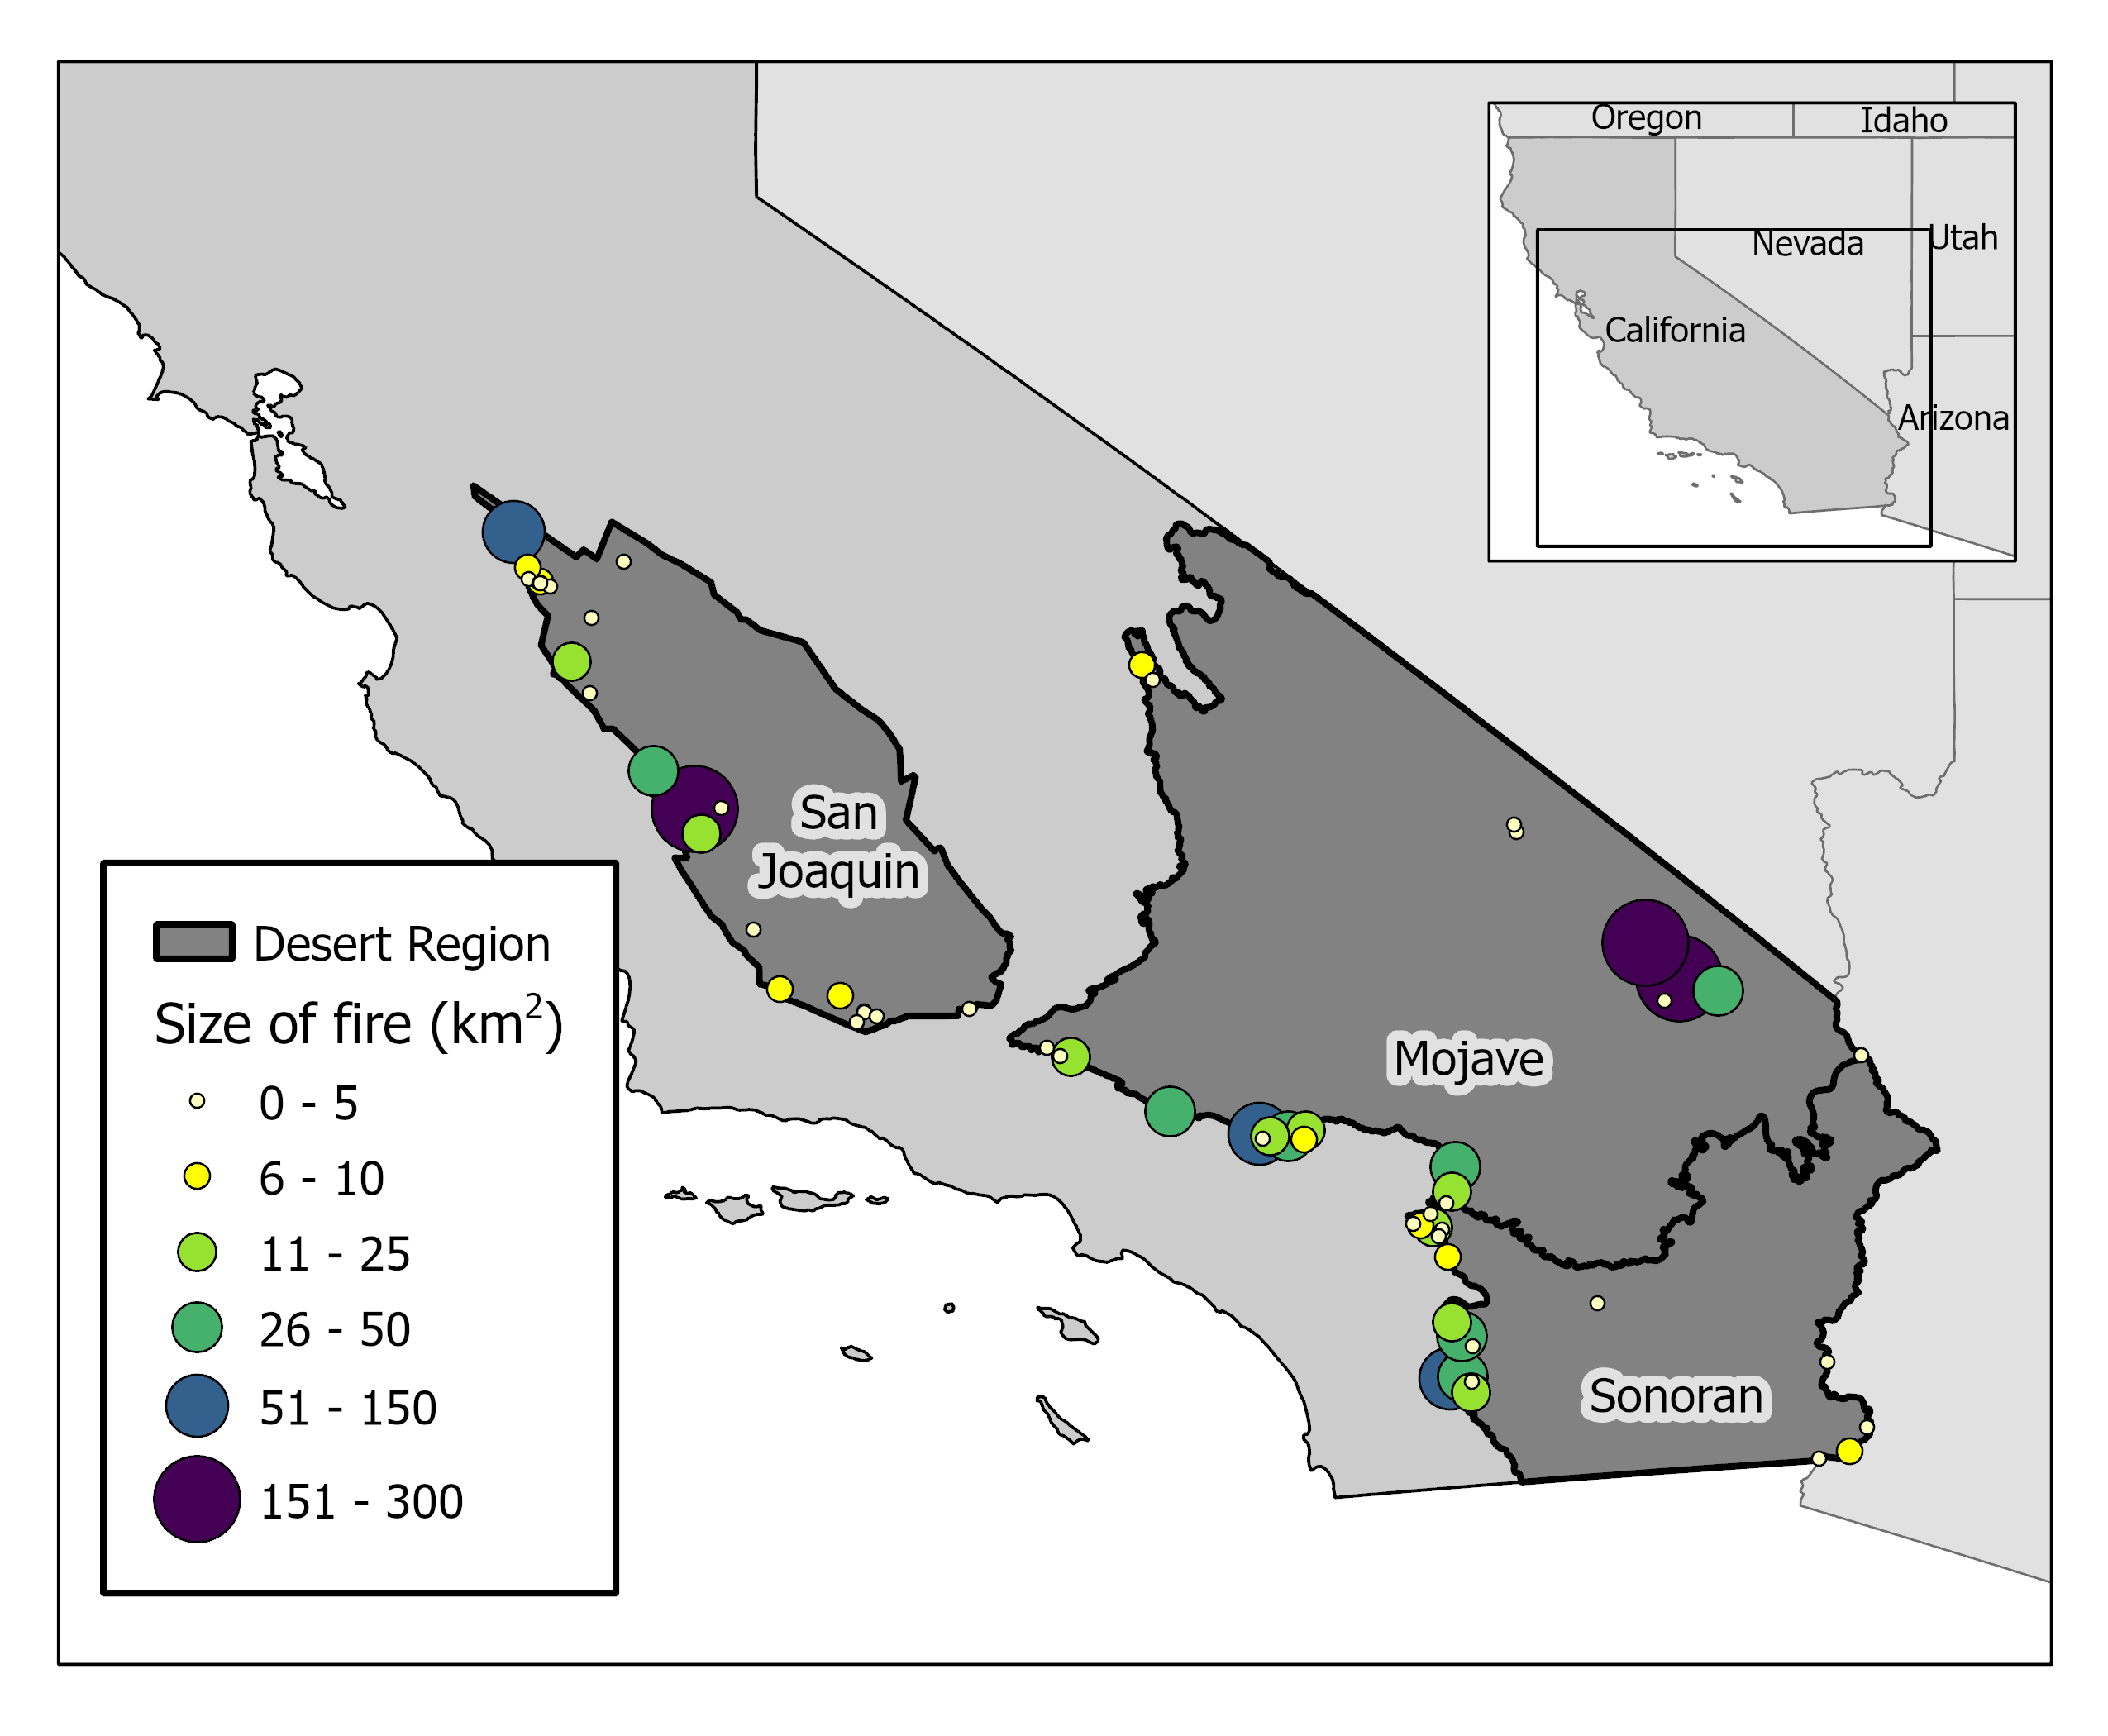
Study Area
Arid lands constitute 32% of total land area in California.
Deserts characterized by low precipitation, arid soils, sparse vegetation, and desert adapted plants and vertebrates
Only fires that burned between 2000-2020 which contained reports of ES occurrences were included.
Desert regionª | Total Area (km²) | Mean annual precipitation at valley floors (mm)^{b} | Total area burned (km²) 2000-2020 | Dominant vegetation^{c}
San Joaquin | 28,008 | 117-269 | 219 (0.8%) | Salt desert scrub, valley grasslands, juniper woodlands, freshwater marsh, riparian
Mojave | 73,883 | 100-200 | 722 (1%) | Creosote bush scrub, salt desert scrub, Mojave mid-elevation scrub, riparian
Sonoran | 26,936 | 70-100 | 399 (1.5%) | Creosote bush scrub, Sonoran mid-elevation scrub, salt desert scrub, riparian
Notes:
ª(Germano et al., 2011; Omernik & Griffith, 2014)
^{b}(Brooks et al., 2018; Germano et al., 2011; Wills, 2006)
SJD - Surrounded by Sierra Nevada and the Coastal ranges
Complex irrigation projects, moving water throughout the valley, have converted the arid southern San Joaquin into one of the world’s most productive agricultural sites. Wills, R. (2018). Central Valley Bioregion. Fire in California’s Ecosystems. Pp 279-297
Fire data were obtained from the National Interagency Fire Center
(20 in the Mojave Desert, 24 in the San Joaquin Desert, and 18 in the Sonoran Desert)

Slide 10
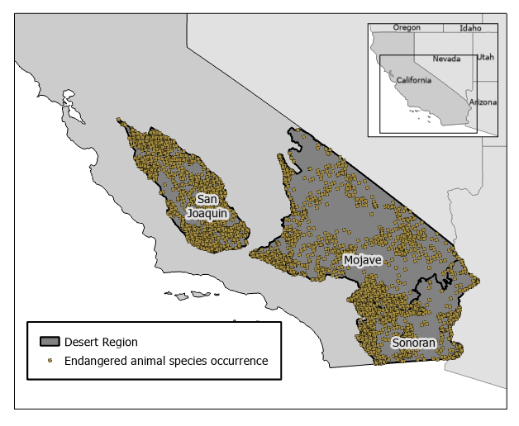
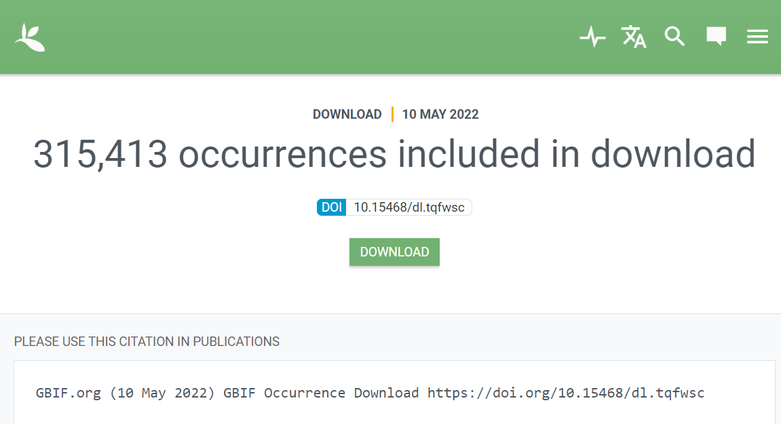

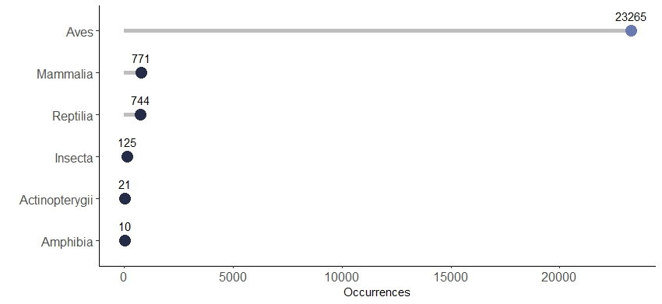
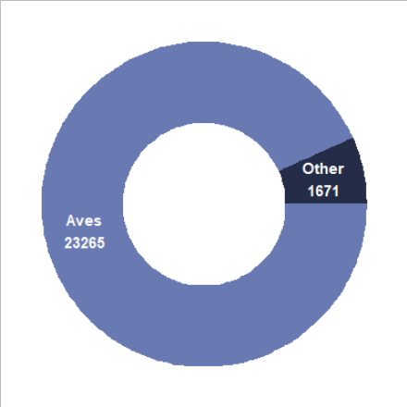
Endangered Species Occurrences
Notes:
A list of state and/or federally endangered and threatened species was used to retrieve and compile georeferenced occurrence data from Global Biodiversity Information Facility (GBIF) on 10 May 2022
36 unique ES were reported within the desert ecoregion
Occurrences reported for the same species on the same day at identical coordinates were found to be duplicates and were removed
Desert regionª
Total Area (km²)
ES occurrences reported in burned region
ES occurrences reported in never-burned region
Mojave
73,883
160
8,692
San Joaquin
28,008
120
9,024
Sonoran
26,936
76
6,874
Almost all (99.6%) of the occurrence records were sourced from citizen science datasets (Table 3). The majority of the data (91%) were published by eBird, comprising nearly half of all GBIF occurrences.

Slide 11
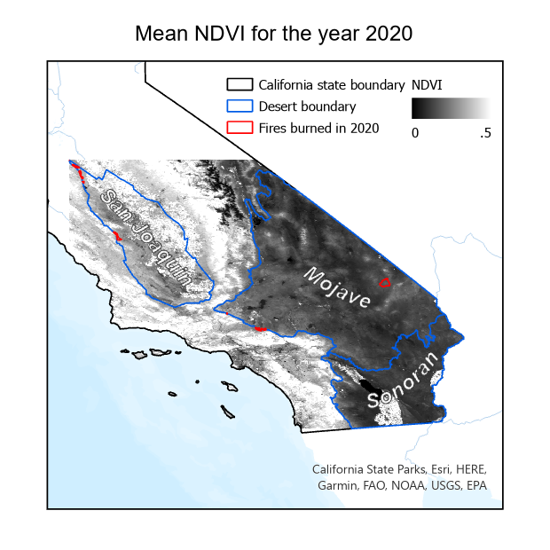
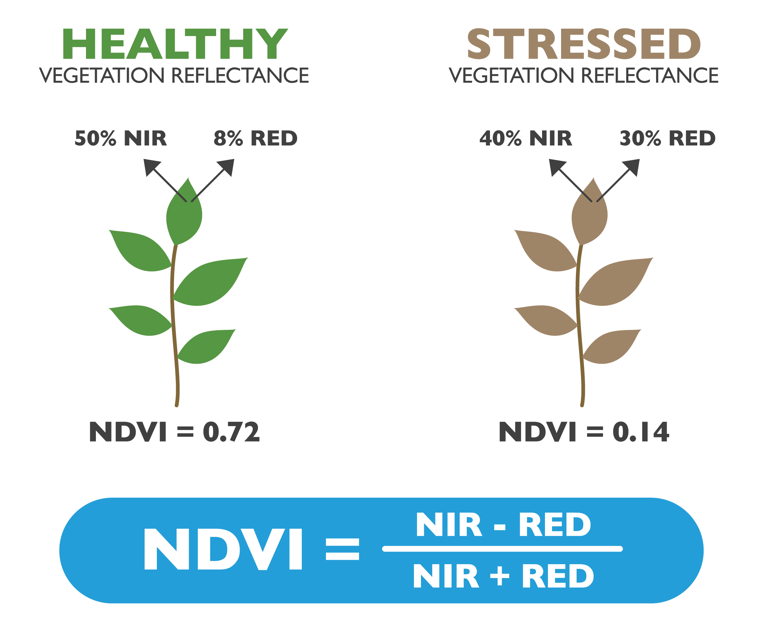
NDVI
An aggregate mean normalized difference vegetation index (NDVI) was used as a proxy for vegetation structure to evaluate the relationship between vegetation quality, fire activity, and occurrences reported over a 20-year period (2000-2020).
Notes:
Monthly NDVI data derived from MOD13C2 products (https://modis.gsfc.nasa.gov/data/dataprod/mod13.php) were downloaded using the ‘MODIStsp’ R package (v2.0.8; Busetto & Ranghetti, 2016) and processed using the ‘raster’ (v3.4-10; Hijmans, 2021) and ‘sf’ (v1.0-7; Pebesma, 2018) R packages. Monthly NDVI raster images were used to calculate annual mean values for the years 2000-2020 (MODIS NDVI data is not available prior to 2000) at 1 km resolution.

Slide 12
Before-After/Control-Impact (BACI) design
Reference-impact analyses between the control sites (i.e., reference condition) and the burned sites (i.e., impacted condition) was used to quantify the impact of fire disturbances on endangered species.
Example A: Compares ES occurrences reported in control and burned regions before and after fire
Example B: Compares ES community similarity between in control and burned regions in the years following fire
Notes:
Reference-impact analyses between the control sites (i.e., reference condition) and the burned sites (i.e., impacted condition) enabled a contrast between reported ES occurrence in areas impacted by fires to those in areas that have historically been unaffected by wildfire to quantify the impact of fire disturbances on (van Mantgem et al., 2001).
the area with no record of fire (i.e., never-burned or unburned area) of each desert region to represent control sites and desert areas that have experienced fires since 2000 (i.e., burned area) to represent the burned sites.

Slide 13
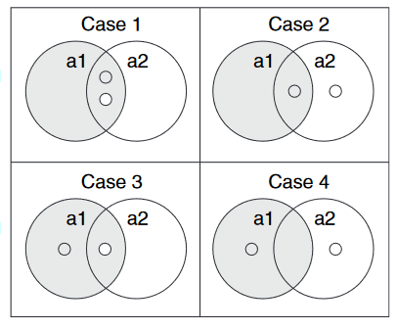
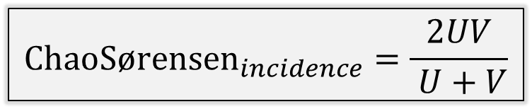

Comparing similarity of ES composition
Incidence-based ChaoSørensen index used to compare burned:control ES composition
$${ChaoSørensen}_{incidence}=\frac{2UV}{ U+V}$$
$U$ = total incidences of shared species (between treatment groups) reported in the burned group
$V$ = total incidences of shared species reported in the unburned group
Sørensen index is calculated by dividing the number of observed species shared between two communities by the sum of all species observed in both communities
Chao uses a probabilistic approach that estimates an adjustment term using observed rare species to account for unseen (i.e. unreported) shared species
burned
unburned
Species selected at random from burned community
Species selected at random from unburned community
(Chao et al., 2005)
Notes:
May want to cut down for time/questions
Sørensen index is calculated by finding the number of species shared between two communities and dividing by the sum of the number of species in each community.
Chao further developed the index by using a probabilistic approach that accounts for sampling bias by using observed rare species to estimate an adjustment term that accounts for unseen, or unreported, shared species.

Slide 14
Comparing similarity of ES composition
Incidence-based ChaoSørensen index used to compare burned:control ES composition
$${ChaoSørensen}_{incidence}=\frac{2UV}{ U+V}$$
$U$ = total incidences of shared species (between treatment groups) reported in the burned group
$V$ = total incidences of shared species reported in the unburned group
(Chao et al., 2005)
Notes:
Evaluating the similarity over the years since fire can help identify a trend in the long-term impact of fire on ES communities

Slide 15
Presentation Outline
Background & objectives
Methodology
Findings
Implications

Slide 16
Results
Most significant findings

Slide 17
Discussion
What are the major findings, and what do they mean with regard to your research
How do these findings relate to what others have found in the past
How can you explain any unusual or surprising result

